Slide 1
Viewing Implicit Social Networks As Bipartite Graphs
Abhishek Vyas MT19086
Mansi Sharma MT19092

Slide 2
Introduction
Knowledge Sharing networks are different from person-to-person social networks . These are implicit social networks where users interact by modifying a common object.
These are different forms from Social networks where the Sender will have the interest in the receiver whereas they will contain the interactions that are due to common object.
For ex: Web site user don’t interact with each other directly as in case of Social network site like Facebook . They would interact with each on the basis of common interests ( Review a Same book).

Slide 3
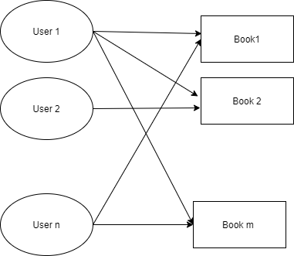
Implicit Network
As Users and the common object/interaction point are independent disjoint sets among themselves . They will form a bipartite graph.

Slide 4
Data set
Different types of networks are made in use to analyse the model:
Tagging Networks : Flicker , Delicious Datasets
User Nodes : Users
Interaction Point : Items
Item Rating Networks : Netflix Prize Dataset
User Nodes : Users
Interaction Point : Movie
Citation Networks : High Energy Physics group
User Nodes : Citers
Interaction Point : Citees Link to Dataset

Slide 5
Preprocessing
Flickr & Delicious :
Dataset given is in the following format : time user tag
So we’ll extract the user and tag information by splitting it by “\t” and add the edge.
Do this for each line to create the Bipartite graph.
Netflix :
File consists data in format movieID: userID, time.
So we’ll extract movieID, combine it with all its corresponding userID. And then add all the pairs to create the bipartite graph.
Citation:
File consists data in format “citers citee” lines by line so first split lines by “\n” than use citers - citee information to make Graph
Graph:

Slide 6
Analysing & Model
Model : Bipartite Graph model for Implicit Social network.
Analysing Global Structure: Degree distribution were analysed for all the datasets.
Rewiring of Graph : Reconnect the user node with the different interaction point randomly.
Analysing Local Structure: Analysed the bipartite clustering coefficient over different number of nodes with actual graph as well as rewired graph.
Analysing Robustness : Largest Connected Component analysed against the % of nodes.

Slide 7
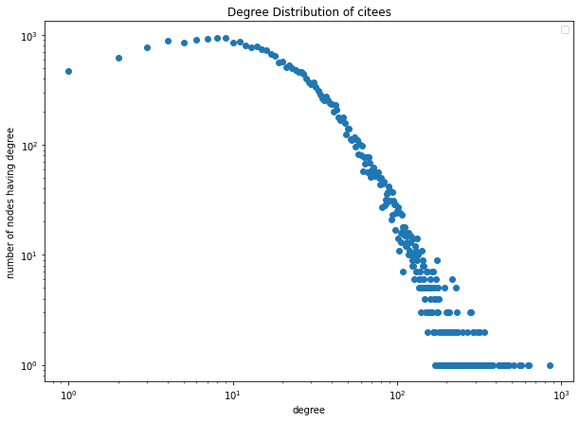
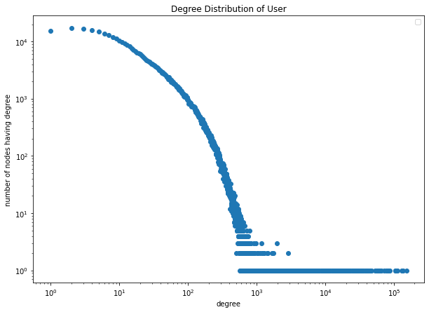
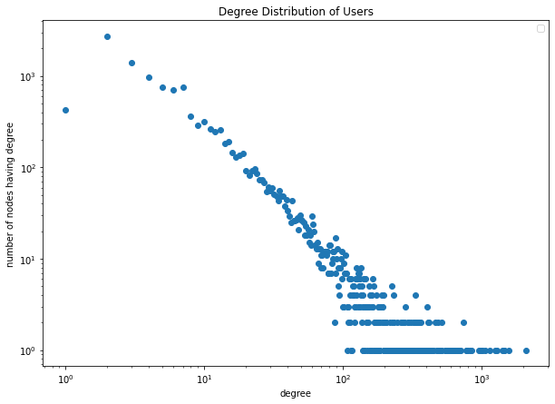
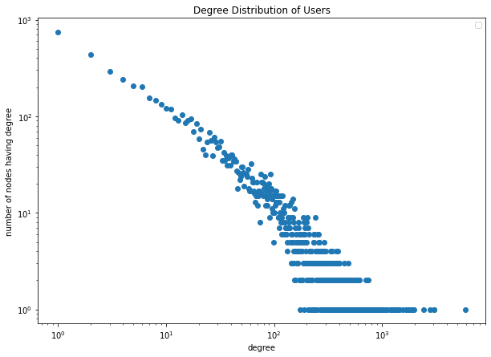
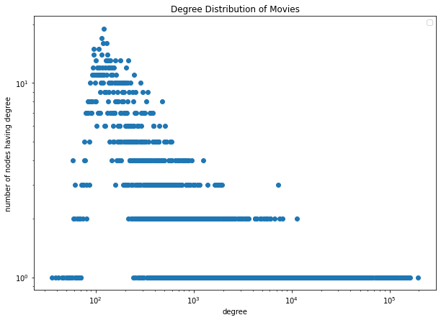
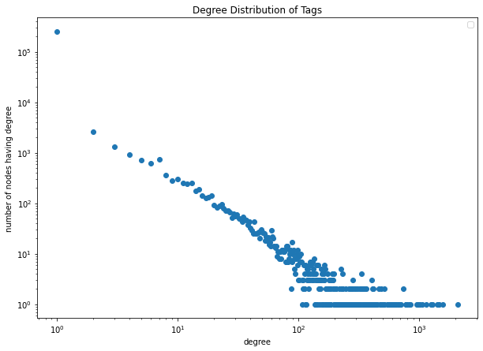
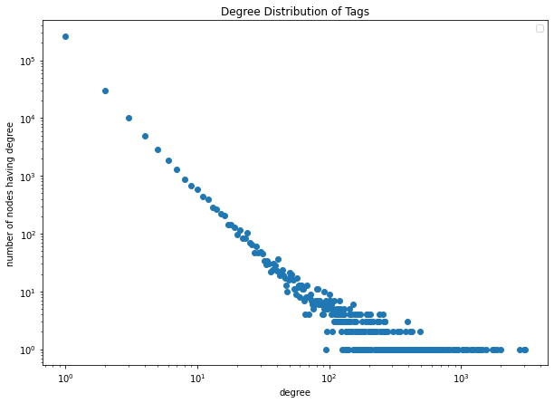
Results - Degree distribution
CITATION
Netflix
Flicker
Delicious

Slide 8
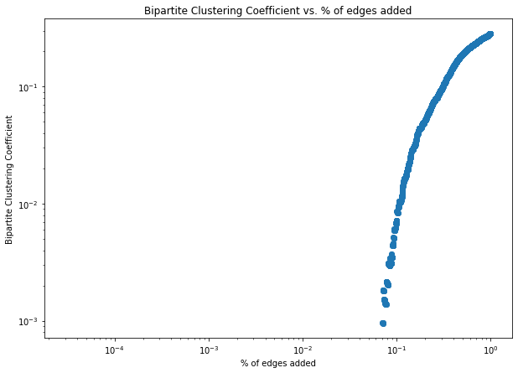
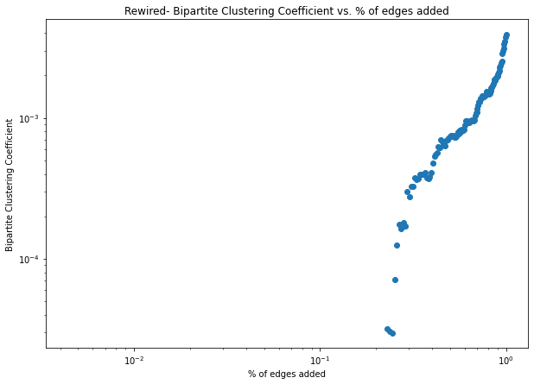
Bipartite Clustering coefficient Vs Nodes
Citations
Citations Rewired

Slide 9
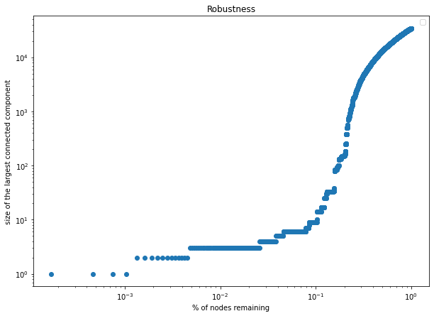
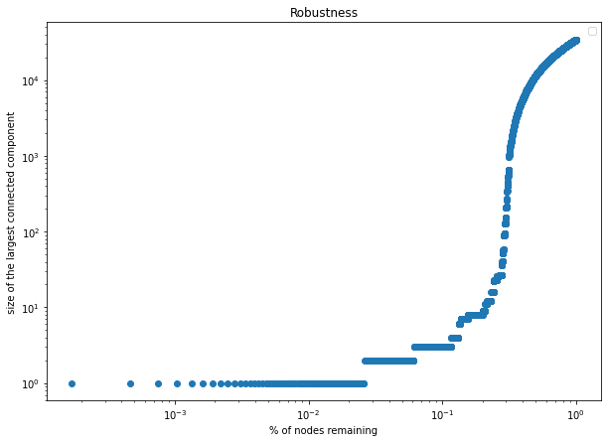
Robustness
Citations
Citations Rewired

Slide 10
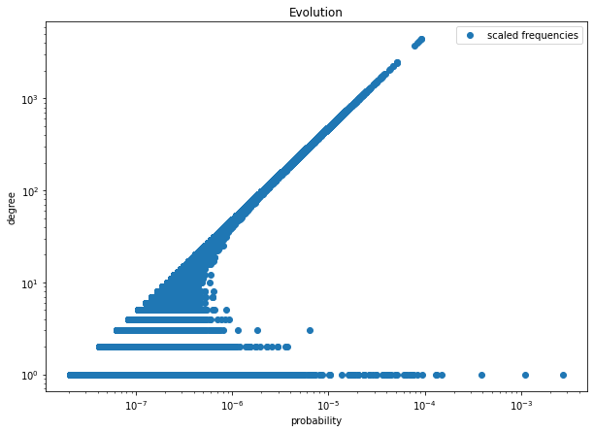
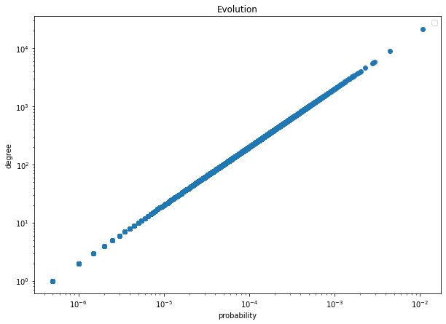

Evolution
Delicious
Netflix
Flickr

Slide 11
Application in real world
These Knowledge Sharing networks had a great applications in Data mining
For example :
Recommendation Systems
Personalisations
Predictions
Clustering
In data mining perspective , shared/Common objects can act as Attributes and User’s can act as Feature Vector

Slide 12
THANKS

